Slide 1

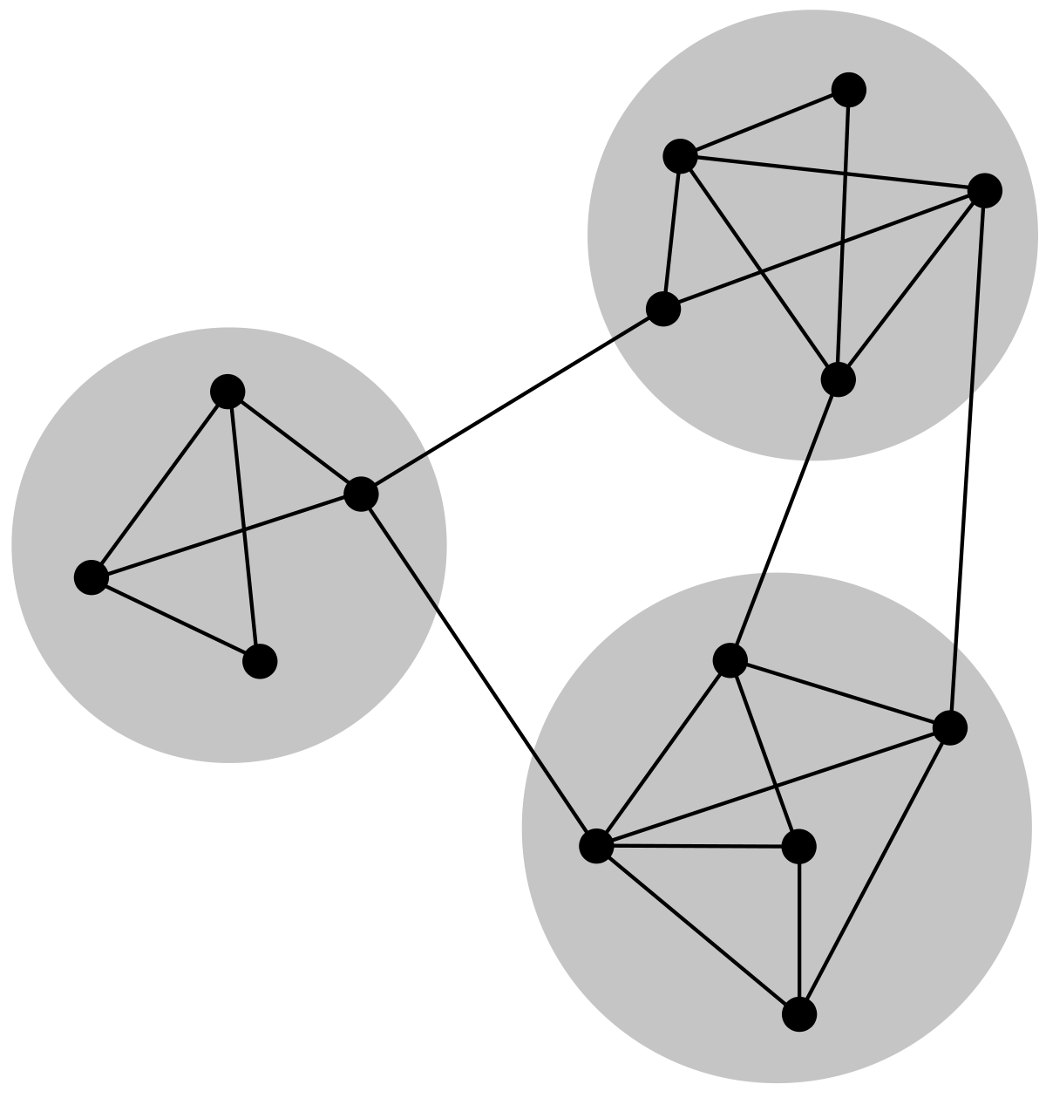
Rise of the Graph André Vala
Lisbon, December 14th, 2019

Slide 2
Wi-Fi Code msevent302db

Slide 3






André Vala
IT Deputy Director | Business Technology
Pestana Hotel Group
/in/andrevala
https://andrevala.com
@atomicvee
andre.vala@gmail.com

Slide 4
Agenda
What is the Microsoft Graph?
What’s New in Microsoft Graph?
Microsoft Graph Capabilities
Microsoft Graph Data Connect
Microsoft Graph Toolkit

Slide 5
What is the Microsoft Graph?

Slide 6
Microsoft Graph is all about you
The fabric of all your data
It all starts with /me

Slide 7
Unified REST API for Microsoft 365
Azure Active Directory
Office 365
SharePoint, OneDrive, Outlook/Exchange, Microsoft Teams, OneNote, Planner, and Excel
Enterprise Security and Mobility
Identity Manager, Intune, Advanced Threat Analytics and Advanced Threat Protection.
Windows 10
Activities and Devices
Education

Slide 8
Gateway to you data in the Microsoft cloud
your app
Web
Apps
Device & Native
Apps
Bots
Background
processes
gateway
Microsoft Graph
Office 365
Windows 10
Enterprise Mobility + Security
Your or your customer’s data
Microsoft identity
Rich content
Deep insights
Real-time updates

Slide 9
What’s New in Microsoft Graph?

Slide 10
November 2019
Preview
Calendar: support for online meetings in outlook
Calendar: set properties of room and room list
Cloud Communication: new call resource type
Devices and Apps: several updates to Intune
Identity and Access: support for conditional access
Mail: change notifications on message resource
Notifications: support for web push
People: new profile resource
Search: new Microsoft Search API
Teamwork: get files associated with teams and channels
Users: new creationType property
Generally Available
Groups: list groups, read basic group properties, read/write the membership of groups
Groups: create groups with application permission
Identity and Access: register applications that authenticate with Azure AD
Mail: new conversationIndex property
Mail: get message or mail folder, track their changes and manage subscriptions for change notifications
Users: check group memberships

Slide 11
December 2019
Preview
Devices and Apps: several updates to Intune
Notifications: change notifications that include resource data
Identity and Access: new API to manage threatAssessementRequest resources
Teamwork: notifications for new/edited channel messages and chat messages
Generally Available
Insights: Insights APIs available in v1.0
Toolkit: version 1.1 released

Slide 12
Microsoft Graph Capabilities

Slide 13
Microsoft Graph Capabilities
Delta queries
Webhooks
Custom data
Working with insights
Batch requests

Slide 14
Delta Queries
Optimize your queries by retrieving only what has changed since you last queried the Graph.
Optional query parameters
Paging with nextLink
Change tokens with deltaLink
Supported resources for delta queries

Slide 15
Optional Query Parameters
Value | Description | Example
$count | Retrieves the total count of matching resources | /me/messages?$top=2&count=true
$expand | Retrieves related resources | /groups?$expand=members
$filter | Filters results (rows) | /users?$filter=startsWith(givenName,’J’)
$orderBy | Orders results | /users?$orderBy=displayName desc
$search | Returns results based on search criteria. Currently supported on messages and person collections | /me/messages?$search=pizza
$select | Filters properties (columns) | /users?$select=givenName,surname
$skip | Indexes into a result set, also used by some APIs to implement paging and can be used together with $top to manually page results | /me/messages?$skip=11
$skipToken | Retrieves the next page of results from result sets that span multiple pages.(Some APIs use $skip instead) | https://graph.microsoft.com/v1.0/users? $skiptoken=X%27445370 ... 0000000%27
$top | Sets the page size of results | /users?$top=10

Slide 16
$filter
Equals – eq
Not equals – ne
Greater than – gt
Greater than or equals – ge
Less than – lt
Less than or equals – le
And – and
Or – or
Not - not
Support for $filter varies across Microsoft Graph APIs, but the following are generally supported:

Slide 17

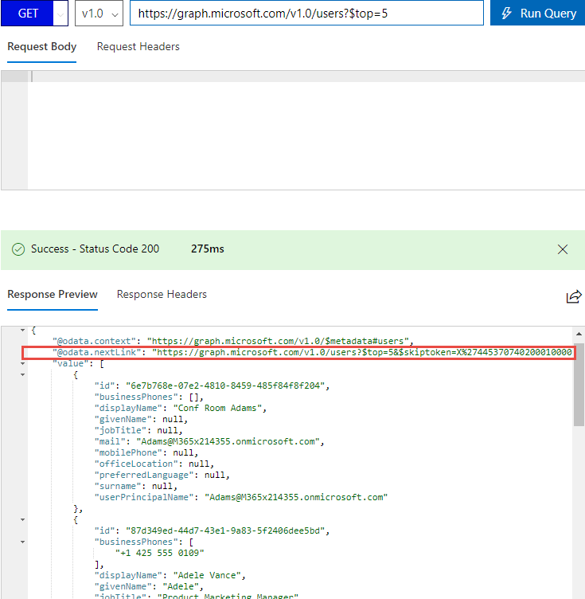
Paging with nextLink
Paging with Microsoft Graph
Some queries return multiple pages of data
Page size is specified using $top query parameter
@odata.nextLink
Presence indicates there are additional pages of data
Provides full URL link to next page of data
API behavior
Not all APIs support paging
Different default and max page sizes
Some support backwards paging (&previous-page=true)

Slide 18
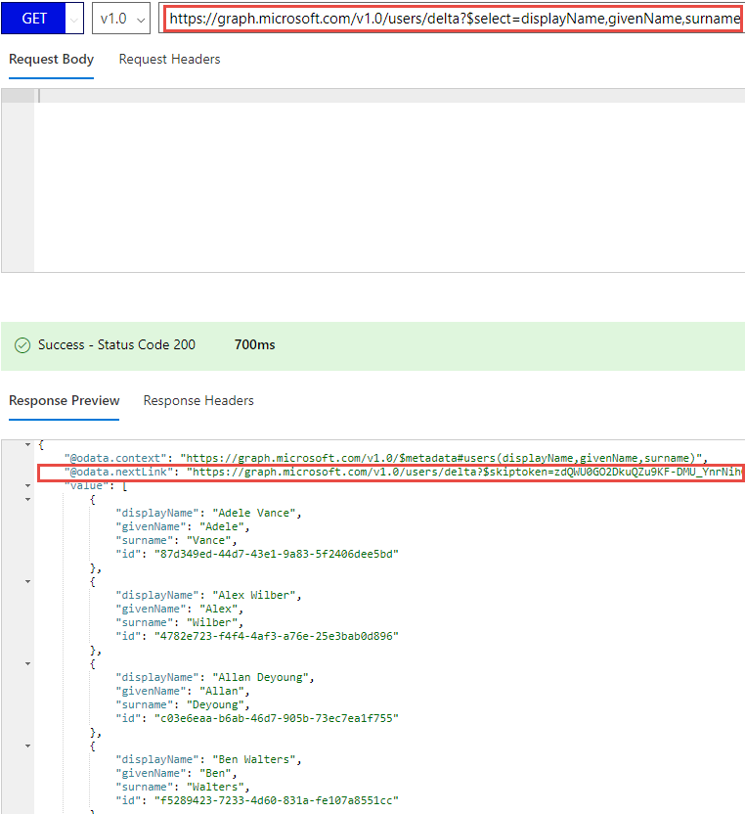
Change tokens with deltaLink
Delta queries
Discover newly created, updated, or deleted entities without a full read of the target resource
Useful for synchronizing changes to a local data store
Requires permission to read the requested resource
@odata.nextLink
The $select query parameter from the initial request is encoded into the nextLink URL
Presence of nextLink indicates more data is available
@odata.deltaLink
Presence of deltaLink indicates no more data to be returned
Contains deltaToken, save this for future queries
If no changes have occurred, the same deltaToken is returned with no results

Slide 19
Typical call pattern to track changes
Application
https://graph.microsoft.com/v1.0
/{resource}/delta?$select=id,displayName
{“@odata.nextLink”:”https://graph.Microsoft.com/v1.0/{resource}/delta?$skipToken=ABC”,
“value”:[{“id”:”1”,”displayName”:”foo”}, {“id”:”2”,”displayName”:”bar”}]}
https://graph.Microsoft.com/v1.0/{resource}/delta?$skipToken=ABC
{“@odata.deltaLink”:”https://graph.Microsoft.com/v1.0/{resource}/delta?$deltaToken=DEF”,
“value”:[{“id”:”3”,”displayName”:”baz”}]}
Sometime later
https://graph.Microsoft.com/v1.0/{resource}/delta?$deltaToken=DEF
{“@odata.deltaLink”:”https://graph.Microsoft.com/v1.0/{resource}/delta?$deltaToken=XYZ”,
“value”:[{“id”:”1”,”displayName”:”My data was updated”}]}

Slide 20
Resources that support delta queries
Resource collection | API
Directory roles | Delta function of the directoryRole resource
Groups | Delta function of the group resource
Mail folders | Delta function of the mailFolder resource
Messages in a folder | Delta function of the message resource
Personal contact folders | Delta function of the contactFolder resource
Personal contacts in a folder | Delta function of the contact resource
Users | Delta function of the user resource
Drive items | * Delta function of the driveItem resource
Events in a calendar view (date range) of the primary calendar | Delta function of the event resource
https://docs.microsoft.com/en-us/graph/delta-query-overview?view=graph-rest-1.0

Slide 21
Delta Queries
Demo
https://github.com/microsoftgraph/msgraph-training-webhooks-customdata-insights/tree/master/Demos/01-user-changes
Notes:
Vesa

Slide 22
Webhooks
Let Microsoft Graph notify your app when specific events occur, instead of polling the Graph waiting for changes.
Webhook subscriptions
Understanding webhook apps
Configuring webhooks
Retrieving changes from webhooks

Slide 23

Microsoft Graph webhook subscriptions
Teams
Groups
1
Subscription request
Tasks
2
Subscription response – HTTP 201 Created
Chats
Calendar
Files
Insights
Microsoft Graph
Messages
Coworkers
User
3
Notifications
Meetings
Devices
People

Slide 24
Token validation and notification responses
Application
https://contoso.com/api
https://graph.microsoft.com/v1.0
HTTP POST /subscriptions + subscription in body
HTTP POST ?validationToken=XYZ
10 seconds
HTTP 200 OK + token in body
HTTP 201 CREATED + subscription in body
HTTP POST + notifications in body
Subscription
timeout
HTTP 202 ACCEPTED
HTTP GET resource
HTTP 200 OK + resource

Slide 25
Understanding webhook apps
Subscriptions
Application sends a subscription request
Microsoft Graph responds with HTTP 201 – Created and a subscription object in the body
Microsoft Graph sends notifications to the HTTPS endpoint during the lifetime of the subscription
Subscriptions require read permission to the resource
Expiration
Subscriptions expire (time varies)
Applications must renew subscription requests
Applications can unsubscribe from subscriptions
Permission type | Supported resource types in Microsoft Graph v1.0
Delegated – work or school account | Contact, conversation, drive, event, message
Delegated – personal Microsoft account | None
Application | Contact, conversation, event, message

Slide 26
Maximum expiration times
Resource | Maximum expiration time
Users | 4230 minutes (~70 hours)
Groups | 4230 minutes (~70 hours)
Mail | 4230 minutes (~70 hours)
Calendar | 4230 minutes (~70 hours)
Contacts | 4230 minutes (~70 hours)
Group conversations | 4230 minutes (~70 hours)
Drive root items | 86400 minutes (~ 60 days)

Slide 27
Webhooks
Demo
https://github.com/microsoftgraph/msgraph-training-webhooks-customdata-insights/tree/master/Demos/02-webhooks
Notes:
Vesa

Slide 28
Custom Data
Add you own data to resources in the Microsoft Graph.
Open Extensions
Schema Extensions

Slide 29
Extending Microsoft Graph
Add custom data to resources using extensions
Keep your app lightweight and store app-specific user profile data in Microsoft Graph
Keep your existing user profile store and add an app-specific identifier to Microsoft Graph
Add metadata to messages to provide new conversation capabilities
Enhance calendar events with contextual data
Two types of extensions
Open extensions – open and flexible
Schema extensions – more versatile: schema is discoverable and shareable, enables filtering

Slide 30
Open Extensions
Good way for developers to get started
Open types that offer a flexible way to add untyped app data directly to a resource instance
Accessible through the extensions navigation property of the resource instance
extensionName is the only pre-defined, writeable property, must be unique within the tenant
Use a reverse DNS naming system (i.e. Com.Contoso.ContactInfo), but do not use Microsoft (com.Microsoft or com.onMicrosoft).

Slide 31
Open Extensions Example
HTTP/1.1 200 OK
Content-Type: application/json
Content-length: 420
{
"id": "84b80893-8749-40a3-97b7-68513b600544",
"displayName": "John Smith",
"mail": "john@contoso.com",
"extensions": [
{
"@odata.type": "#microsoft.graph.openTypeExtension",
"extensionName": "com.contoso.roamingSettings",
"id": "com.contoso.roamingSettings",
"theme": "dark",
"color": "purple",
"lang": "Japanese"
}
]
}

Slide 32
Schema Extensions
Versatility
Define schema extension definition and extend resource instances with strongly-typed custom data.
Discoverable by other apps via status property
Schema extensions are complex types, enabling use of HTTP verbs:
POST to specify custom data when creating a new resource instance
GET to read the custom data
PATCH to add or update in an existing resource instance
PATCH to set the complex type to null, deleting the custom data

Slide 33
Schema Extensions Example
GET https://graph.microsoft.com/v1.0/groups?$filter=graphlearn_courses/courseId eq ‘123’& $select=displayName,id,description,graphlearn_courses
HTTP/1.1 200 OK
Content-Type: application/json
Content-length: 326
{
"value": [
{
"displayName": "New Managers March 2017",
"id": "14429ae5-3e74-41a2-9fa8-028fbb984637",
"description": "New Managers training course for March 2017",
"graphlearn_courses": {
"@odata.type": "#microsoft.graph.ComplexExtensionValue",
"courseId":"123",
"courseName":"New Managers",
"courseType":"Online"
}
}
]
}

Slide 34
Supported Resources
Resource | Open extensions | Schema extensions
Administrative unit | Preview only | Preview only
Calendar event | GA | GA
Device | GA | GA
Group | GA | GA
Group calendar event | GA | GA
Group conversation post | GA | GA
Message | GA | GA
Organization | GA | GA
Personal contact | GA | GA
User | GA | GA

Slide 35
Schema Extensions Lifecycle
State | Lifecycle state behavior
InDevelopment | Initial state. Only the owner app can extend resource instances with this schema definition, and only in the same directory where the owner app is registered. Only the owner app can update the extension definition with additive changes or delete it. The owner app can move from InDevelopment to Available
Available | Available for use by all apps in any tenant. Any app can add custom data to instances of those resource types (as long as it has permission to the resource). Only the owner app can update the extension definition with additive changes. No app can delete the extension definition while in this state. The owner app can move from Available to Deprecated.
Deprecated | Schema extension definition can no longer be read or modified. No app can view, update, add new properties, or delete the extension. Apps can, however, still read, update, or delete existing extension property values. The owner app can move from Deprecated back to Available.

Slide 36
Permissions and Data Limits
Permissions
The same permissions that are required to read or write from a resource are required to read or write to any extensions on that resource.
To create and manage schema definitions, app must be granted Directory.AccessAsUser.All
Data limits
Open extension limits
Each open extension can have up to 2KB of data (including the extension definition itself)
An application can add up to two open extensions per resource instance
Schema extension limits
An application may create no more than five schema extension definitions
Directory resources (device, group, and user) limit total number of property extension values to be set on a resource instance to 100

Slide 37
Custom Data
Demo
https://github.com/microsoftgraph/msgraph-training-webhooks-customdata-insights/tree/master/Demos/03-custom-data
Notes:
Vesa

Slide 38
Working with Insights
Leverage relationships calculated by the Graph using advanced analytics and machine learning.
Understanding the Insights resource type
Trending
Used
Shared
Retrieving insights collections

Slide 39
Understanding the Insights resource type
Relationships calculated using advanced analytics and machine learning
Trending – documents from OneDrive and SharePoint sites trending around a user
Used – documents viewed and modified by a user
Documents the user used in OneDrive for Business
SharePoint
Opened as email attachments
Shared – documents shared with a user as email attachments or OneDrive for Business links sent in emails
https://graph.microsoft.com/v1.0/me/insights/{api}

Slide 40
Permissions for Insights
Permission type | Permissions (least to most privileged)
Delegated (work or school account) | Sites.Read.All, Sites.ReadWrite.All
Delegated (personal Microsoft account) | Not supported
Application | Sites.Read.All, Sites.ReadWrite.All

Slide 41
Returned Data
Every insight is returned with both a resourceVisualization and a resourceReference complex value type
resourceReference – reference to the item
webUrl
id
Type
resourceVisualization – visualization data, used to display the item
title
type
mediaType
previewImageUrl
previewText
containerWebUrl
containerDisplayName
containerType

Slide 42
Trending
Rich relationship connecting a user to documents that are trending around the user (are relevant to the user). OneDrive files, and files stored on SharePoint team sites can trend around the user.
{
"id": "string",
"weight": "double",
"resourceVisualization": [{"@odata.type": "microsoft.graph.resourceVisualization"}],
"resourceReference": [{"@odata.type": "microsoft.graph.resourceReference"}],
"resource": [ { "@odata.type": "microsoft.graph.entity" } ]
}

Slide 43
Used
An insight representing documents used by a specific user. The insights returns the most relevant documents that a user viewed or accessed. This includes documents in:
OneDrive for Business
SharePoint
{
"id": "string",
"lastUsed": "usageDetails",
"resourceVisualization": "resourceVisualization",
"resourceReference": "resourceReference",
"resource": [ { "@odata.type": "microsoft.graph.entity" } ]
}

Slide 44
Shared
An insight representing files shared with or by a specific user. The following shared files are supported:
Files attached directly in an email or a meeting invite.
OneDrive for Bussiness and SharePoint modern attachments - files stored in OneDrive for Business and SharePoint that users share as a links in an email.
{
"id": "string",
"lastShared": "sharingDetail",
"resourceVisualization": "resourceVisualization",
"resourceReference": "resourceReference",
"resource": [ { "@odata.type": "microsoft.graph.entity" } ]
}

Slide 45
Retrieving Insights Collections
Get the items trending around me
https://graph.microsoft.com/v1.0/me/insights/trending
Get the resourceVisualization for the items trending around me
https://graph.microsoft.com/v1.0/me/insights/trending?$select=resourceVisualization
Get the resourceVisualization for my shared items that are attachments in emails
https://graph.microsoft.com/v1.0/me/insights/shared?$sharingType eq 'Attachment'&$select=resourceVisualization
Show the OneNote notebooks that I have used
https://graph.microsoft.com/v1.0/me/insights/used?$filter=resourceVisualization/type eq 'OneNote'

Slide 46
Working with Insights
Demo
https://github.com/microsoftgraph/msgraph-training-webhooks-customdata-insights/tree/master/Demos/04-insights
Notes:
Vesa

Slide 47
Batch Requests
Optimize multiple requests by using batches and sequence requests using dependencies.
Batch request
Batch response
Sequencing requests
Bypassing URL lenght limits

Slide 48
Batch Request
Request format
Batch requests are always sent using POST to the /$batch endpoint.
A JSON batch request body consists of a single JSON object with one required property: requests
The requests property is an array of individual requests. For each individual request, the id, method, and url properties are required.
The id property functions primarily as a correlation value to associate individual responses with requests.
The method and url properties are exactly what you would see at the start of any given HTTP request.
Individual requests can optionally also contain a headers property and a body property.

Slide 49
Batch Request Example
POST https://graph.microsoft.com/v1.0/$batch
Accept: application/json
Content-Type: application/json
{
"requests": [
{
"id": "1",
"method": "GET",
"url": "/me/drive/root:/{file}:/content"
},
{
"id": “2",
"url": "/me",
"method": "PATCH",
"body": {
"city" : "Redmond"
},
"headers": {
"Content-Type": "application/json"
}
}
]
}

Slide 50
Batch Response
Response format
The property in the main JSON object is named responses as opposed to requests
Individual responses might appear in a different order than the requests
Individual responses have a status property. The value of status is a number that represents the HTTP status code.
The status code on a batch response is typically 200 or 400. If the batch request itself is malformed, the status code is 400.
A 200 status code on the batch response does not indicate that the individual requests inside the batch succeeded.
A nextLink property might be included in the batch response. To ensure that all individual responses have been received, continue to follow the nextLink as long as it exists.

Slide 51
Batch Response Example
200 OK
Content-Type: application/json
{
"responses": [
{
"id": "1",
"status": 302,
"headers": {
"location": "https://b0mpua-by3301.files.1drv.com/y23vmagahszhxzlcvhasdhasghasodfi"
}
},
{
"id": "4",
"status": 204,
"body": null
}
]
}

Slide 52
Sequencing Requests
Sequencing requests with the dependsOn property
The dependsOn property is an array of strings that reference the id of a different individual request.
The values for id must be unique.
POST https://graph.microsoft.com/v1.0/$batch
Accept: application/json
Content-Type: application/json
{
"requests": [
{
"id": "1",
"method": "GET",
"url": "..."
},
{
"id": "2",
"dependsOn": [ "1" ],
"method": "GET",
"url": "..."
}
]
}

Slide 53
Bypassing URL length limitations
Versatility
An additional use case for JSON batching is to bypass URL length limitations.
In cases where the filter clause is complex, the URL length might surpass limitations built into browsers or other HTTP clients.
You can use JSON batching as a workaround for running these requests because the lengthy URL simply becomes part of the request payload.

Slide 54
Batch Requests
Demo
https://github.com/microsoftgraph/msgraph-training-webhooks-customdata-insights/tree/master/Demos/05-batch
Notes:
Vesa

Slide 55
Microsoft Graph Data Connect

Slide 56
Challenging scenarios with Microsoft Graph
Today’s most interesting data-driven applications
require reasoning & analysis over massive datasets
built by extracting data from Office 365 via Microsoft Graph APIs
Microsoft Graph is optimized for simple, real-time, entity centric queries, not:
Data Access in bulk - requires expensive engineering
Data Privacy is at risk - given the current all-or-nothing consent models
Data Security & Data Governance - entirely up to the experience author

Slide 57
What is Microsoft Graph Data Connect?
New model for data access & hosting applications within the customer’s control
Allows developers to build intelligent applications and experiences using Office 365 data & Azure resources
Application access to customer data requires explicit customer approval
Microsoft Graph remains the best approach for enabling end-user task centric apps

Slide 58







Microsoft Graph Data Connect
Apply defined data controls
Securely extend Office 365 data to Azure
Enable big data and machine learning
Data at scale
Office 365
Azure
Customer data
Granular consent
Product data
Security & Governance
Industry data
Customer’s MS Cloud

Slide 59
Graph APIs vs Data Connect
 | Graph APIs | Graph data connect
Access scope | Single use / entire tenant | Many users / groups
Access pattern | Real time | Recurrent schedule
Data operations | Operates on data master | Operates on cache of the data
Data protection | Data is protected while in Microsoft 365 | Data protection is extended to the cache of data in your Azure subscription
User consent | Self; resource types | None
Admin consent | Entire organization; resource types | Select groups of users; resource types & properties; excludes users
Access tools | RESTful web queries | Azure Data Factory

Slide 60
Microsoft Graph Toolkit

Slide 61
Microsoft Graph Toolkit
Collection of reusable, framework-agnostic web components and helpers for accessing and working with Microsoft Graph.
Supported in React and Angular
Supported in all latest versions of browsers
https://docs.microsoft.com/en-us/graph/toolkit/overview

Slide 62
Microsoft Graph Toolkit Components
Person
Display a person or contact by using their photo, name and/or email address.
Person Card
Responsive component to display more information related to a person.
People
Display a group of people or contacts by using their photos or initials.
People Picker
Searches for a specified number of people and render the list of results.
Login
Button and flyout control to facilitiate Microsoft identity platform authentication.
Get
Make any GET query from Microsoft Graph directly in your HTML.
Agenda
Represents events in a user or group calendar.
Tasks
Enables the user to view, add, remove, complete, or edit tasks. It works with tasks in Microsoft Planner or Microsoft To-Do.

Slide 63
Labs

Slide 64

Lab #1
120 mins
Building Microsoft
Graph Applications
In this lab
Build a .NET console application using Microsoft Graph
Build a Javascript application using Microsoft Graph
Build an Azure Function using Microsoft Graph
Build a mobile application with Xamarin using Microsoft Graph
https://github.com/microsoftgraph/msgraph-training-building-apps/blob/master/Lab.md

Slide 65
Lab #2
120 mins
Authenticate and Connect to Microsoft Graph
In this lab
Obtain tokens and connect with the Microsoft Graph using REST
Connecting with Microsoft Graph using OpenID Connect
Dynamic Permissions with the Azure AD v2.0 endpoint and Microsoft Graph
https://github.com/microsoftgraph/msgraph-training-authentication/blob/master/lab.md

Slide 66
Lab #3
120 mins
Microsoft Graph Capabilities
In this lab
Microsoft Graph delta queries
Microsoft Graph webhooks
Adding custom data to resources in Microsoft Graph
Developing insights with Microsoft Graph
Creating batch requests with Microsoft Graph
https://github.com/microsoftgraph/msgraph-training-webhooks-customdata-insights/blob/master/Lab.md

Slide 67
Lab #4
120 mins
Build apps with the Microsoft Graph REST API
In this lab
Create an Azure AD web application with the App Registration Portal
Working with the Microsoft Graph REST API in Postman
Create & configure an ASP.NET MVC web application & configure it for MSAL
Update the ASP.NET MVC application to leverage the Microsoft Graph REST API
https://github.com/microsoftgraph/msgraph-training-restapi/blob/master/Lab.md

Slide 68
Lab #5
120 mins
Using Microsoft Graph data connect to analyze emails to find subject matter experts
In this lab
Setup tenant & get data out of Office 365 with Graph Data Connect and Data Factory
Extract Office 365 data with Graph Data Connect
Process the exported data
https://github.com/microsoftgraph/msgraph-training-dataconnect/blob/master/Lab.md

Slide 69
Lab #6
45 mins
Optimize data usage when using Microsoft Graph with query parameters
In this lab
Demonstrate how to manipulate REST queries with query parameteres
Create queries that expand complex entities
Demonstrate how to search for content with Microsoft Graph
Optimize Microsoft Graph queries with batching
https://docs.microsoft.com/en-us/learn/modules/optimize-data-usage/

Slide 70
Lab #7
70 mins
Optimize network traffic with Microsoft Graph
In this lab
Explain how Microsoft Graph maintains resource health
Identify when Microsoft Graph throttles requests
Decide the appropriate pattern to address throttled requests
Create queries that mitigate throttling scenarios
https://docs.microsoft.com/en-us/learn/modules/optimize-network-traffic/

Slide 71

Questions?
/in/andrevala
https://andrevala.com
@atomicvee
andre.vala@gmail.com

